Slide 1
Points to be Discussed
Basic Concepts and Notations
Data Structures and operations on Data Structures
Types of Data Structures
Mathematical Notations and Functions
Algorithmic Complexity with Best, Average and Worst Cases
Big O Notation

Slide 2
Basic concepts and notations

Slide 3
Basic Concepts & Notations
Data: Data can be defined as representation of facts, concepts or instructions in some manner.
Data Item(Field): A set of characters which are used together to represent a specific data item.
Record: It is a collection of related data items.
File: It is a collection of related records.
Entity: It is a person, place, thing or concept about which information is recorded.

Slide 4
DATA sTRUCTURES

Slide 5
Data Structures
Data + Structure = Data Structure
The logical or mathematical model of particular organization of data is known as Data Structure. It is the organized collection of data.
The data structure is a process of how the data items are organized in computer memory for the processing.

Slide 6
Data Structures
The choice of a particular data model depends on two considerations:
It must be rich enough in structure to mirror the actual relationships of the data in the real world.
The structure should be simple enough that one can effectively process the data when necessary.

Slide 7
Types of data structures

Slide 8
Types of Data Structures
Data Structures
Linear Non-Linear
Elements form Sequence
Elements do not form Sequence
Arrays
Linked- Lists
Stacks
Queues
Trees
Graphs

Slide 9
Types of Data Structures
Arrays:
The simplest type of Data Structures is a linear array. By linear array we mean a list of finite number n of similar data elements, usually 1,2,3,4,…….,n
Linked Lists:
Linked List is a collection of nodes. Each node is divided into two parts. First part contains the info of the data item and the second part contains the pointer to the next node

Slide 10
Types of Data Structures
Stacks:
A Stack, also called Last-In-First-Out(LIFO) system, is a linear list in which insertions and deletions can take place only at one end “top”
Queues:
A Queue, also called First-In-First-Out(FIFO) system, is a linear list in which deletions can take place only at one end “front” and insertions can take place at the other end “rear”

Slide 11
Types of Data Structures
Trees:
Trees are non-linear data structure used to represent the data containing a hierarchical relationship between elements, e.g., records, family trees, and tables of contents
Graphs:
A Graph is a non-linear data structure having a set V of elements called nodes and set E of edges such that each edge e is identified with a unique pair [u,v] of nodes in V, denoted by e=[u,v]

Slide 12
Operations on data structures

Slide 13
Operations on Data Structures
The Data appearing in our Data Structures are processed by means of certain operations
Traversing:
Accessing each record exactly once so that certain items in the record may be processed
Inserting:
Adding a new record to the Structure
Deleting:
Removing a record from the Structure

Slide 14
Operations on Data Structures
Sorting:
Arranging the records in some logical order
Searching:
Finding the location of the record with a given key value, or finding the locations of all records which satisfy one or more conditions
Merging:
Combining the records in two different sorted files into a single sorted file

Slide 15
Mathematical notations and functions

Slide 16
Mathematical Notations & Functions
Floor and Ceiling Functions:
Let x be any real number. Then x lies b/w two integers called the floor and ceiling of x.
Remainder Function:
Let k be any integer and let M be a positive integer. Then k(mod M) will denote the integer remainder when k is divided by M.
Integer and Absolute Functions:
Let x be any real number. The integer value of x, written INT(x), converts x into an integer by deleting the fractional part of the number.

Slide 17
Mathematical Notations & Functions
Factorial Function:
The product of the positive integers from 1 to n, inclusive is denoted by n!. That is:
n!=1.2.3.4.5.6…..(n-2)(n-1)n
Permutations:
A permutation of a set of n elements is an arrangement of the elements in a given order. Example – Arranging the elements abc
Exponents and Algorithms:
The value of log depends on the base of algorithm. Commonly used bases are 10, 2, and e.

Slide 18
Algorithmic complexity

Slide 19
Algorithmic Complexity
An algorithm is a sequence of steps that gives method of solving a problem. It creates the logic of program. Efficiency of program depends on two major criteria, first one is run time of that algorithm and second is the space.
Runtime of algorithm means the time taken by the program for execution. We implement different data structures, some data structures take more space but improves the runtime and some takes less space but it effects runtime of algorithm.

Slide 20
Algorithmic Complexity
The complexity of an algorithm M is the function f(n) which gives the running time and/or storage space requirement of the algorithm in terms of the size n of the input data. Frequently, the storage space required by an algorithm is simply a multiple of the data size n.

Slide 21
Algorithmic Complexity
1.Best Case: In this case, algorithm searches the element in first time itself. Ex- Searching with linear search.
2.Average Case: In average case we take the probability with list of data. Average case of algorithm should be the average number of steps but since data can be at any place, so finding exact behavior of algorithm is difficult.
3.Worst Case: In this case we find the element at the end or when searching of element fails.

Slide 22
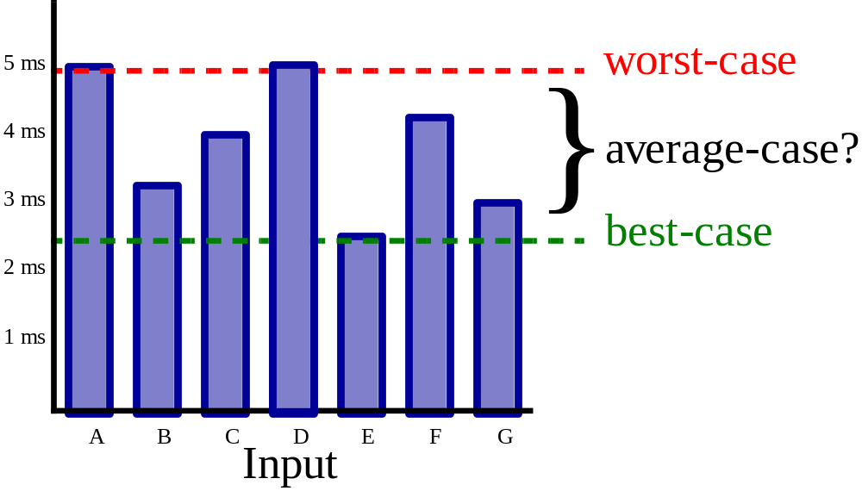
Algorithmic Complexity

Slide 23
Big o notation

Slide 24
BIG O NOTATION
Definition:-
Suppose functions f(n) and g(n) are functions defined on positive integer number n, then function f(n) = O(g(n)), read as “ f of n is big O of g of n” , or as “f(n) is of the order of g(n)”, if there exists positive constants c and no, such that f(n) <= c* g(n) for all values of n>=no

Slide 25
Big O Notation
Big O Notation is used to measure the performance of any algorithm. Performance of any algorithm depends on input of any data. It is proportional to the input data. For a particular input size n we know how a particular algorithm behaves but when n increases and it becomes larger, then the same algorithm behaves differently. So O notation defines the order of growth of any algorithm which is useful to measure the performance of algorithm.
Suppose M is an algorithm, and suppose n is the size of the input data. Clearly the complexity f(n) of M increases as n increases. It is usually the rate of increase of f(n) that we want

Slide 26
Big O Notation
to examine. This is usually done by comparing f(n) with some standard function such as
log₂n, n, n log₂n, n², n³, 2^{n}
The rates of growth of these functions are as:
 | log₂n | n | n log ₂n | n² | n³ | 2^{n}
5 | 3 | 5 | 15 | 25 | 125 | 32
10 | 4 | 10 | 40 | 100 | 10³ | 10³
100 | 7 | 100 | 700 | 10⁴ | 10⁶ | 10³⁰
1000 | 10 | 10³ | 10⁴ | 10⁶ | 10⁹ | 10³⁰⁰

Slide 27
Big O Notation
O(1): When we get data in first time itself. ( Constant Computing time)
O(n): When all the elements of list will be traversed( Execute in Linear time)
O(n²): When the full list be traversed for each element (Quadratic time)
O(log₂n): When we divide list half each time and traverse the middle element
O(n log₂n): When we divide list half each time and traverse that half portion
O(n³): it increments every element in an n.n.n 3d array of integers (Cubic time)
O(2^{n})- This time increase very dramatically in relation to the size of n.(Exponential time)

